Slide 1
ESC101: Fundamentals of Computing
scanf (continued) and
Data Types in C
Nisheeth

Slide 2
How does scanf work ?
How we must speak to mr. compiler
How we usually speak to a human
scanf(“%d%d”, &a, &b);
Please read one integer. Ignore all whitespace (spaces,tabs,newlines) after that till I write another integer. Read that second integer too.
Store value of the first integer in a and value of second integer in b.
Format string
Format string tells me how you will write things, and then I am told where to store what I have read
Remember Mr. C likes to be told beforehand what all we are going to ask him to do!
Scanf follows this exact same rule while telling Mr. C how to read

Slide 3
How does scanf work ?
Be a bit careful since Mr C is a bit careless in this matter
He treats all whitespace characters the same when integers are being input
scanf will never print anything
Use printf to print and scanf to read
Try out what happens with the following
My advice to you is to take input one at a time in the beginning ☺ Try out acrobatics in free time
Hmm … you are going to write the English word Hello followed by space followed by an integer. I will store the value of that integer in a
scanf(“Hello %d”,&a);
scanf(“%d %d”,&a,&b);
scanf(“%dHello%d”,&a,&b);
scanf(“%d,%d”,&a,&b);
scanf(“\“%d%d\“”,&a,&b);
scanf(“%d\n%d”,&a,&b);
scanf(“%d\t%d”,&a,&b);

Slide 4


Commenting
Very important programming practice
int main(){
int a; // My first int
int b; // The other int
// Assign them values
a = 5, b = 4;
a + b;
return 0;
}
int main(){
int a; /* My first int */
int b; /* The other int */
/* Assign them values */
a = 5, b = 4;
a + b;
return 0;
}
int main(){
int a; // My first int
int b; // The other int
/* Assign them values */
a = 5, b = 4;
a + b;
return 0;
}
Yes. In fact /* */ is used to comment several lines at once – shortcut!
So I can mix and match?
Just be a bit careful. Some compilers don’t understand // comments

Slide 5
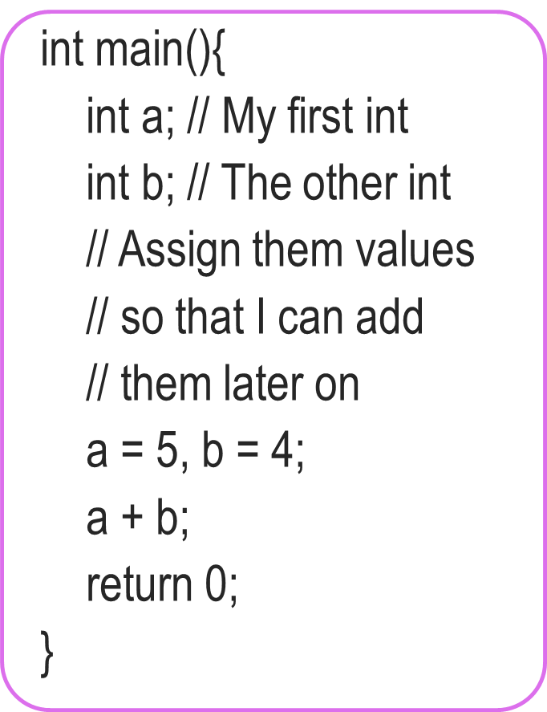
More on Comments
Use comments to describe why you defined each variable and what each step of your code is doing
You will thank yourself for doing this when you are looking at your own code before the end sem exams
Your team members in your company/research group will also thank you
Multiline comments very handy. No need to write // on every line
int main(){
int a; // My first int
int b; // The other int
/* Assign them values
so that I can add
them later on */
a = 5, b = 4;
a + b;
return 0;
}

Slide 6


A Useful Tip While Problem-Solving
Comments can be also used to identify where is error
Mr C will tell you (compile) where he thinks the error is
Commenting out lines can also help identify the error
Error!
Okay!
Okay!
int main(){
int a, b;
c = a + b;
a = 5;
b = 4;
return 0;
}
int main(){
int a, b;
// c = a + b;
a = 5;
b = 4;
return 0;
}
int main(){
int a, b, c;
c = a + b;
a = 5;
b = 4;
return 0;
}
Aha! I forgot to declare c

Slide 7
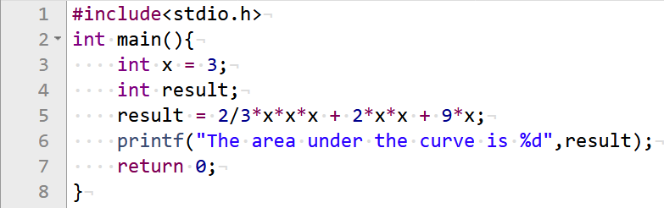


A Useful Tip While Solving Problems
Print your solutions to each one of these pieces to see where going wrong
Try breaking up the problem into smaller pieces
I have no idea what is going wrong here!

Slide 8
A Useful Tip While Solving Problems
Equals 0

Slide 9
A Useful Tip While Solving Problems
Replace this part by (2*x*x*x)/3

Slide 10
Basic Data Types in C
Int: %d specifier
Integers like 156, -3, etc
float (short form of “floating point number”) and double: %f specifier
Real numbers like 3.14, 2.0, -1.3, etc
double is like float but has larger range
char (short form of “character”): %c specifier
Single letter (a-z or A-Z), single digit, or single special character
A char is always enclosed in inverted single commas
Some examples: ‘a’, ‘A’, ‘2’, ‘$’, ‘=‘
These basic data types can also be used with a modifier
Modifiers change the normal behaviour of a data type (e.g., its range of values) and memory storage space required (more on next slides)

Slide 11
Type Modifiers in C
signed (used with int, float/double, char)
signed means the data type can have positive and negative values
int, float/double, char are signed by default (no need to write ‘signed’)
unsigned (used with int, char)
unsigned means the data type can have only take positive values
short (used with int)
short means it uses only half of the memory size of a normal int
long (used with int)
long means it uses twice the memory size of a normal int
Can store a larger range of values of that type

Slide 12
Various C Data Types without/with Modifiers
int (signed int)
%d
unsigned int
%u
short int (short)
%d
long int (long)
%ld
short unsigned
%u
long unsigned
%lu
Yes, multiple modifiers also allowed
float
%f
double
%lf
long double
%Lf
char
%c
unsigned char
%u

Slide 13
int
Can store integers between -2,147,483,648 and 2,147,483,647
#include <stdio.h>
int main(){
int a;
scanf(“%d”, &a);
printf(“My first int %d”, a);
return 0;
}
Range: -2^31 to (2^31)-1
signed int uses 32 bits
(4 bytes, 8 bits = 1 byte)
on recent compilers)
%d
a
Integer arithmetic applies to integers +, -, /, *, %, ()
Have worked with them a lot so far

Slide 14
Printing well-formatted outputs using printf
When printing an int value, place a number between % and d (say %5d) which will specify number of columns to use for displaying that value
Output
2345
2345
123
2345
int x = 2345, y=123;
printf("%d\n",x); //Usual (and left aligned)
printf("%6d\n",x); //Display using 6 columns (right aligned)
printf("%6d\n",y);
printf("%2d\n",x); //Less columns than digits, same as %d
Note: So far, we have only seen how to print integers.
We will see how to print other types of variables later today

Slide 15
long int (usually written just long)
Really long – can store integers between
-9,223,372,036,854,775,808 and 9,223,372,036,854,775,807
Range: -2^63 to (2^63)-1
long int uses 64 bits
on recent compilers
#include <stdio.h>
int main(){
long a; //long int also
scanf(“%ld”, &a);
printf(“My first long int %ld”, a);
return 0;
}
a
Integer arithmetic applies to long int as well +, -, /, *, %, ()
Try them out on Prutor
How does long work with int int + long, int * long?
Will see in next class…
%ld

Slide 16


float
float uses 32 bits (4 bytes).
Why this range for double?
Will see reason later
int, long allow us to store, do math formulae with integers
float allows us to store, do math formulae with reals
#include <stdio.h>
int main(){
float a;
scanf(“%f”, &a);
printf(“My first real %f”, a);
return 0;
}
Very large range ± 3.4e+38
Arithmetic operations apply to float as well +, -, /, *, ()
Try them out on Prutor
a
%f
What happened to remainder %?
I remember. Remainders make sense for integers, not for real numbers
Did you ever do remainders with real numbers in school?

Slide 17

printf revisit: Printing of float/double
Too many decimal digits being printed. Can I just print one or two?
Correct!
Value of a = 123.456700
Value of a = 1.234567e+02
Value of a = 123.46
Value of a = 1.23e+02
Both %f and %lf work for float and double
For long double, %Lf needed
Can use %e if want answer in exponential notation
Yes. Use %0.2f to print 2 decimal places
Oh right. The usual rules of rounding apply here too. 1.5644 will become 1.56 if rounded to 2 places but 1.5654 will become 1.57
#include <stdio.h>
int main(){
double a = 123.4567;
printf(“Value of a = %f”, a);
return 0;
}
#include <stdio.h>
int main(){
double a = 123.4567;
printf(“Value of a = %e”, a);
return 0;
}
Sure. Just like I did it for integer display. See next slide ☺
Great. So can you also help me control the format in which float/double is displayed on screen?
%0.2f”, a);
%0.2e”, a);
Be careful, I am rounding while giving answer correct to 2 decimal places
123.4567 → 123.46
1.234567 → 1.23

Slide 18
printf revisit: Controlled printing of float/double
Already saw how to use printf for well-formatted int display
Can also control how to display a float/double using printf
Can do it using “%a.bf” specifier where a and b are numbers
Here a is the total field width (number of columns) in which the float will be displayed, b is the number of digits printed after decimal
float pi = 3.141592;
printf("%f\n",pi); //Usual
printf("%6.2f\n", pi); //2 decimal
printf("%0.4f\n",pi); //4 decimal
// Note rounding off!
Output
3.141592
3.14
3.1416

Slide 19
double
Double can also handle real numbers but very large ones
Similar relation to float as long has to int
#include <stdio.h>
int main(){
double a;
scanf(“%f”, &a);
printf(“My first real %f”, a);
return 0;
}
Very large range ± 1.79e+308
Arithmetic operations apply to double as well +, -, /, *, ()
There is something called long double as well
Use %Lf to work with long doubles
Try these out on Prutor
a
%lf works too!

Slide 20
char
Basically, a char is a symbol
Internally stored as an integer between -128 and 127 (if signed char) or between 0 and 255 (if unsigned char)
#include <stdio.h>
int main(){
char a = ‘p’;
printf(“My first char %c\n”, a);
printf(“ASCII value of %c is %d”,a,a);
return 0;
}
Char constants enclosed in ‘ ’
Integer arithmetic applies to char as well +, -, /, *, %, ()
Case sensitive ‘a’, ‘A’ different
Various usages (e.g., in arrays of characters – strings), will see more later
‘p’
%c
a
This Will print the ASCII value (integer) of this character

Slide 21
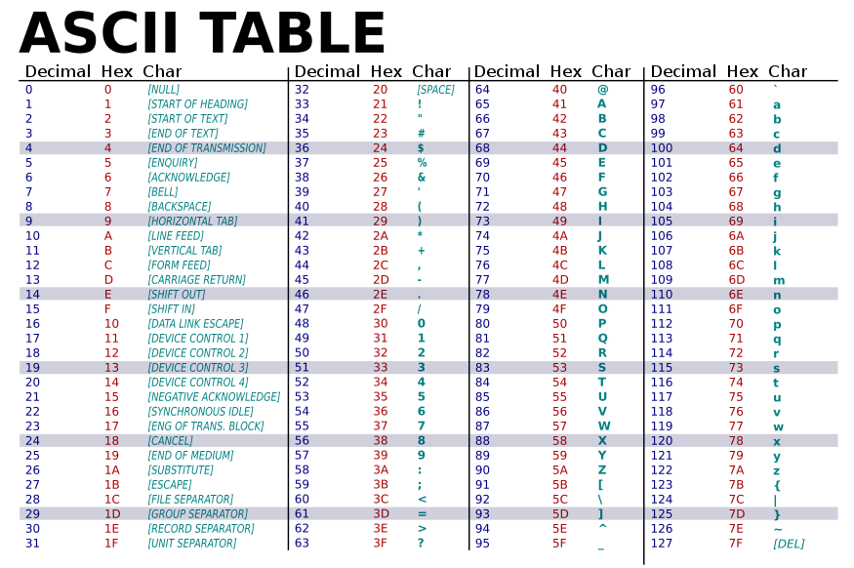
American Standard Code for Information Interchange
\t
\n

Slide 22
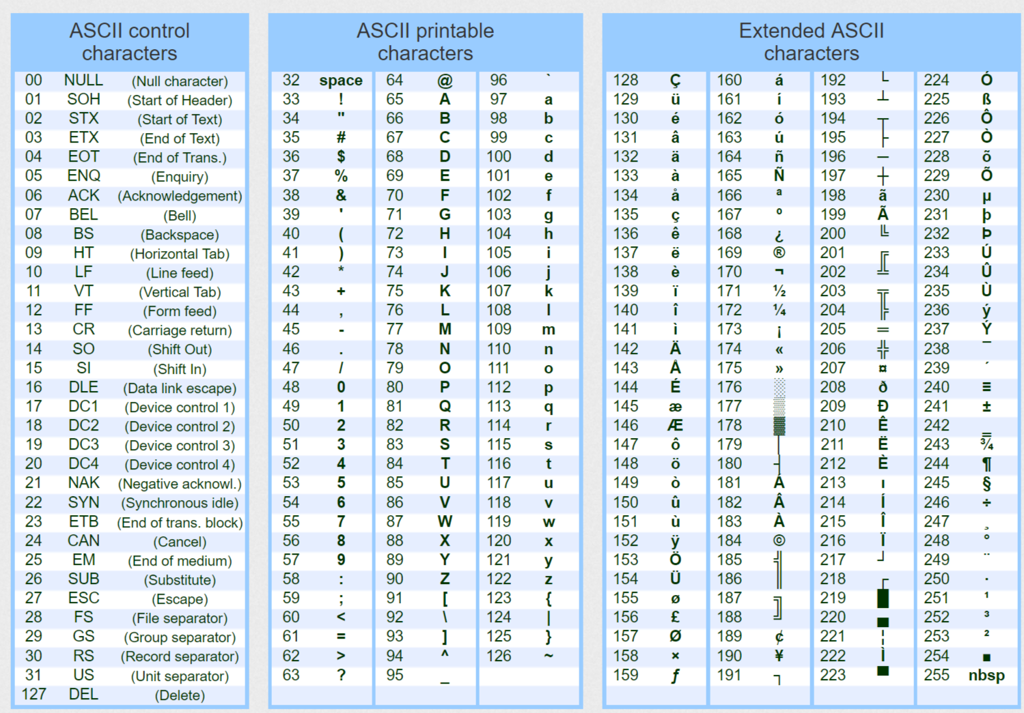
ASCII Table with Extended Characters

Slide 23
Mixing Types in C Expressions
We can have C expression with variables/constants of several types
Certain rules exist that decide the type of the final value computed
Demotion and Promotion are two common rules
During demotion/promotion, the RHS value doesn’t change, only the data type of the RHS value changes to the data type of LHS variable
int a = 2/3; // a will be 0 (no demotion/promotion)
float a = 2/3; // a will be 0.0 (RHS is int with value 0, promoted to float with value 0.0)
int a = 2/3.0; // a will be 0 (RHS is float with value 0.66, becomes int with value 0)
float a = 2/3.0; // a will be 0.66 (RHS is float with value 0.66, no demotion/promotion)
int a = 9/2; // a will be 4 (RHS is int with value 4, no demotion/promotion)
float a = 9/2; // a will be 4.0 (RHS is int with value 4, becomes float with value 4.0)

Slide 24
Type Casting or Typecasting
Also remember: When assigning values, I always compute the RHS first
Converting values of one type to other.
Example: int to float and float to int (also applies to other types)
Conversion can be implicit or explicit. Typecasting is the explicit way
Automatic (compiler)
By us
int k =5;
float x = k; // good implicit conversion, x gets 5.0
float y = k/10; // poor implicit conversion, y gets 0.0
float z = ((float) k)/10; // Explicit conversion by typecasting, z gets 0.5
float z = k/10.0; // this works too (explicit without typecasting), z gets 0.5

Slide 25


Typecasting: An Example Program
But be careful about which one you are typecasting
Also, typecasting just one variable on RHS is enough
#include <stdio.h>
int main(){
int total = 100, marks = 50;
float percentage;
percentage = (marks/total)*100;
printf("%.2f",percentage);
return 0;
}
#include <stdio.h>
int main(){
int total = 100, marks=50;
float percentage;
percentage = (float)marks/total*100;
printf("%.2f",percentage);
return 0;
}
Typecasting makes it 50.0/100 which equals 0.5
Several other ways also possible, e.g., proper bracketing.
Equals 0
0.00
50.00

Slide 26
Typecasting is Nice. But Take Care..
#include <stdio.h>
int main(){
float x; int y;
x = 5.67;
y = (int) x; // typecast (convert) float to int
printf(“%d”,y);
return 0;
}
#include <stdio.h>
int main(){
float x; int y;
x = 1.0e50; // 10^50
y = (int) x; // typecast (convert) float to int
printf(“%d”,y);
return 0;
}
Expected conversion
-2147483648
5
No. 1.0e50 is too big to be cast as an int (or even long – try yourself)
Reverse typecasting error can happen too: Sometimes converting a smaller data type (say int) to larger data type (say float) can also give unexpected results (more on this later in the semester)
Are you kidding?
Unexpected!

